Slide 1
SPORTS PREDICTION (FIFA 19)

Slide 2
TEAM MEMBERS
Abishek Roy B J - CB.EN.U4CSE20003
Aditya Krishna V - CB.EN.U4CSE20004
Ram Gopal - CB.EN.U4CSE20053
Sai Krishnan R - CB.EN.U4CSE20056
Shri Pranav S - CB.EN.U4CSE20061

Slide 3
—DAVE WATERS
“A baby learns to crawl, walk and then run. We are in the crawling stage when it comes to applying machine learning.”

Slide 4
INTRODUCTION
Sports Prediction is a regression problem where the sports result is affected by multiple variables.
The objective is to predict the result of a particular match in the tournament and for that, we are using an quantitative approach (technical analysis) by considering the various factors that affect the result of the match.
The procedure is to prepare the data, preprocess the data, explore and visualize the data, and model the data.

Slide 5
Objective
To analyse a large dataset consisting different player parameters to model Sports Model
Analyzing through Decision Trees classifier algorithm for the FIFA -19 Dataset
Output will be checked for correctness and model will be optimized accordingly to improve the production.

Slide 6

Libraries used
Numpy
Pandas
Seaborn
Logistic regression
Classification report
Confusion matrix
Train test split

Slide 7
What does the project comprise of ?
1
2
3
4
DATA CLEANING
DATA REDUCTION
Data cleaning is the process of fixing or removing incorrect, corrupted, incorrectly formatted, duplicate, or incomplete data within a dataset.
Data reduction is the process of reducing the amount of capacity required to store data
DATA MODELLING
DATA VISUALIZATION
Data visualization is the graphical representation of information and data.
Data modeling is the process of analyzing and defining all the different data your business collects and produces, as well as the relationships between those bits of data.

Slide 8
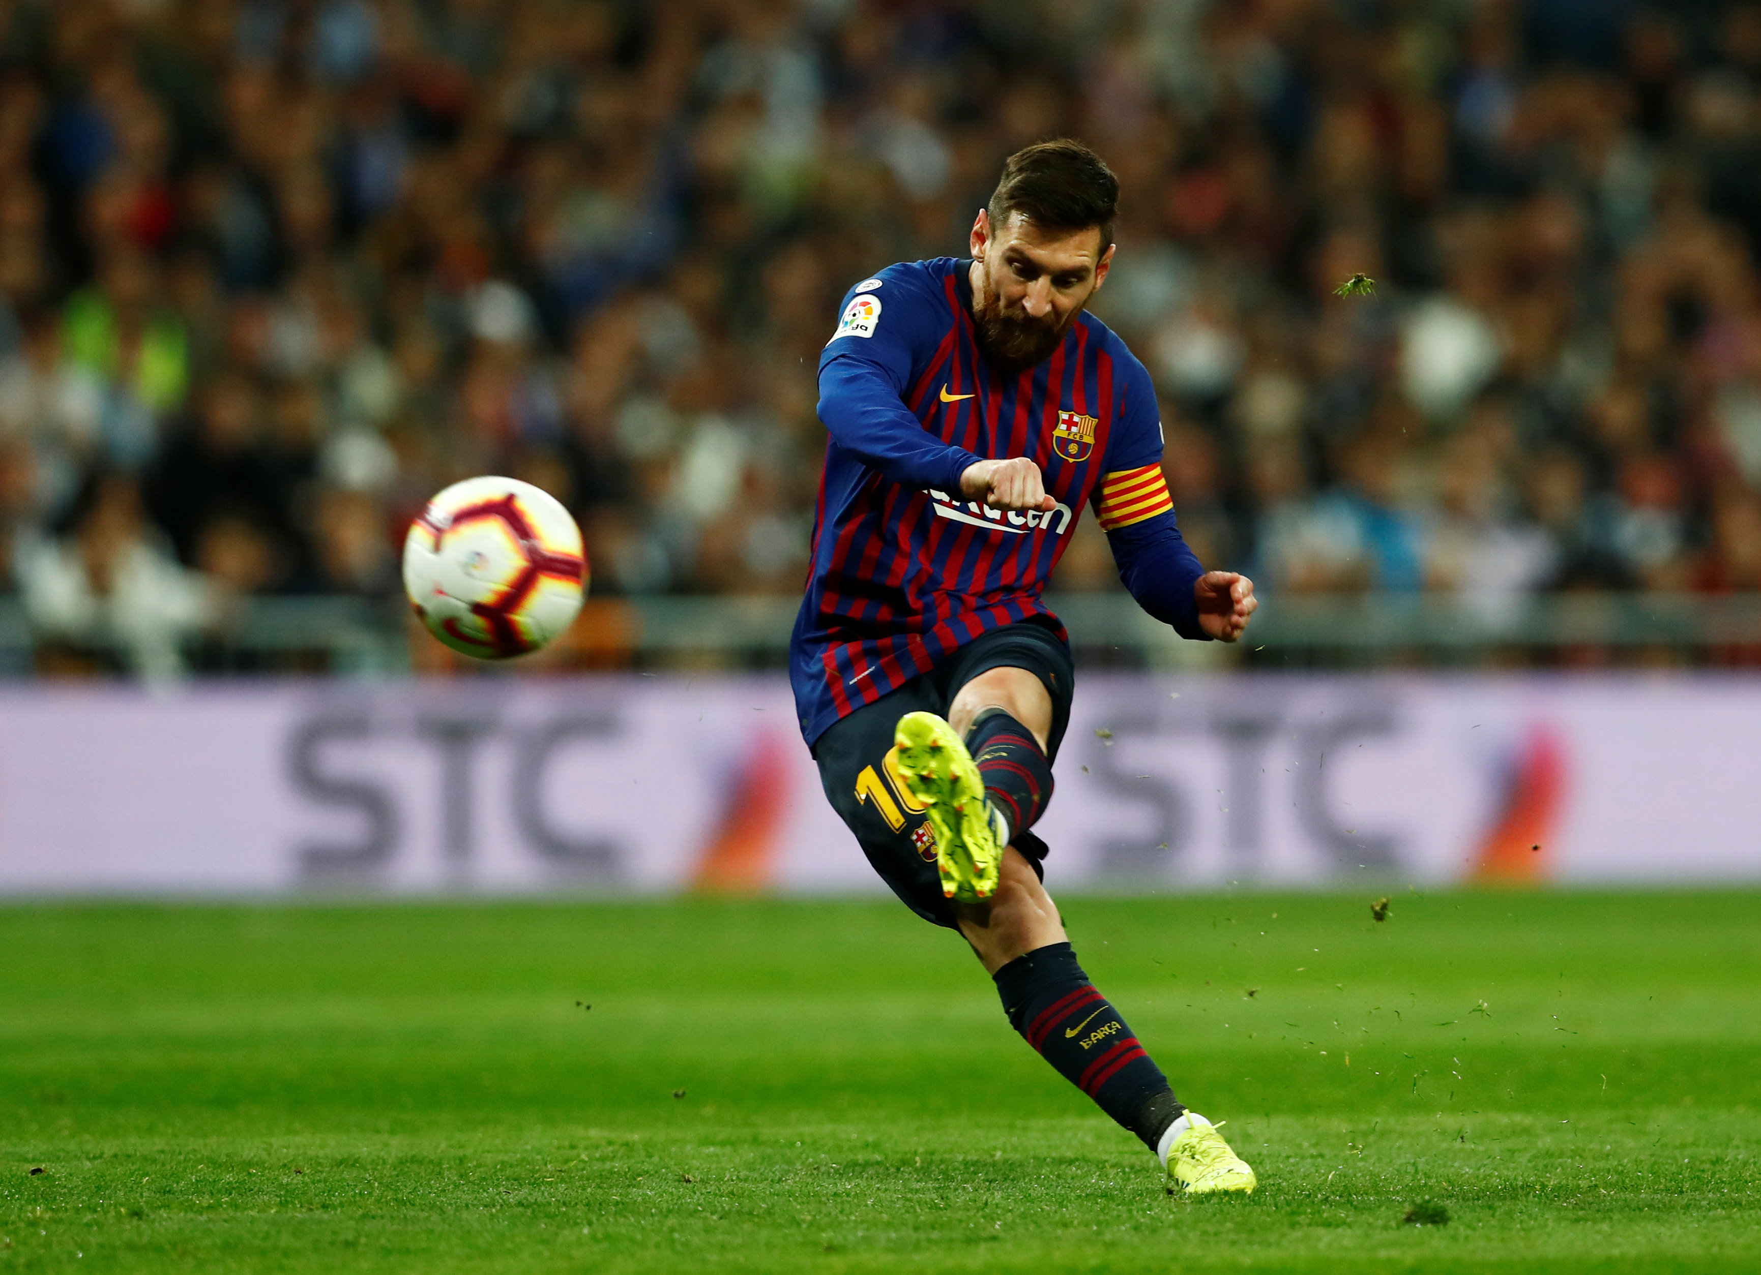
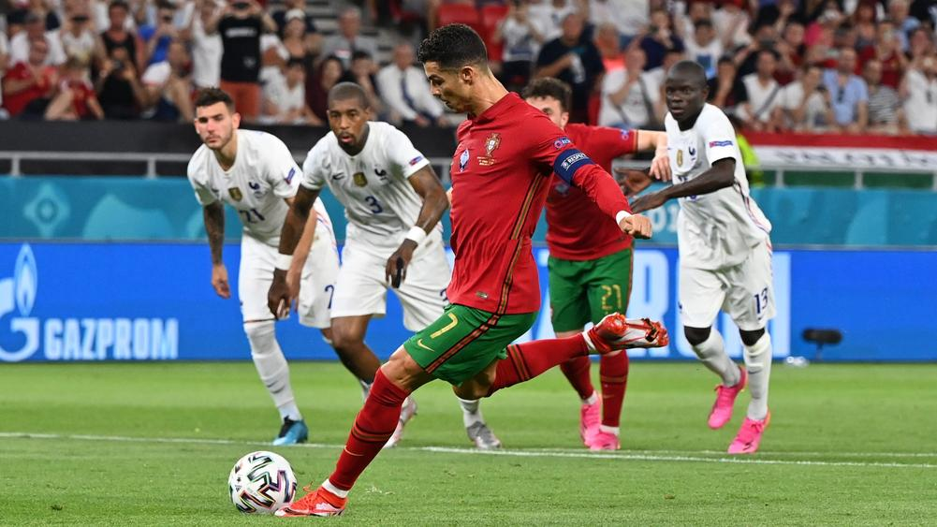
To get a robust knowledge about the dataset you need to classify the data
LEFT FOOTED
RIGHT FOOTED

Slide 9
...OR MAYBE YOU COULD CLASSIFY FURTHER
MID FIELDER
DEFENDER
STRIKER
A midfielder is an outfield position in association football. Midfielders may play an exclusively defensive role, breaking up attacks, and are in that case known as defensive midfielders.
A defender is an outfield position whose primary role is to stop attacks during the game and prevent the opposition from scoring.
Forward are outfield positions in an association football team who play the furthest up the pitch and are therefore most responsible for scoring goals as well as assisting them.

Slide 10
For Data Visualisation, we have used:
Box plots
Bar plots
Count plots
Line plots
Pie Charts
Scatter plots
Boxen Plots
Violin Plots
Lm plots
Sub plots
Pair plots
Histograms
Dist plots
Skewness and kurtosis
Spider plots
Heat maps
Kernel Distribution Estimation Plot
Decision Trees

Slide 11
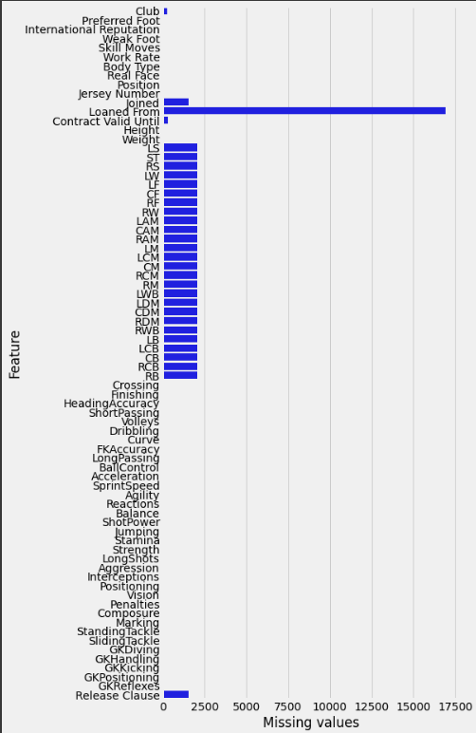
This Bar plot represents the amount of missing values in each column of the FIFA-19 Dataset
Inference:
Loaned from has the highest number of missing values

Slide 12
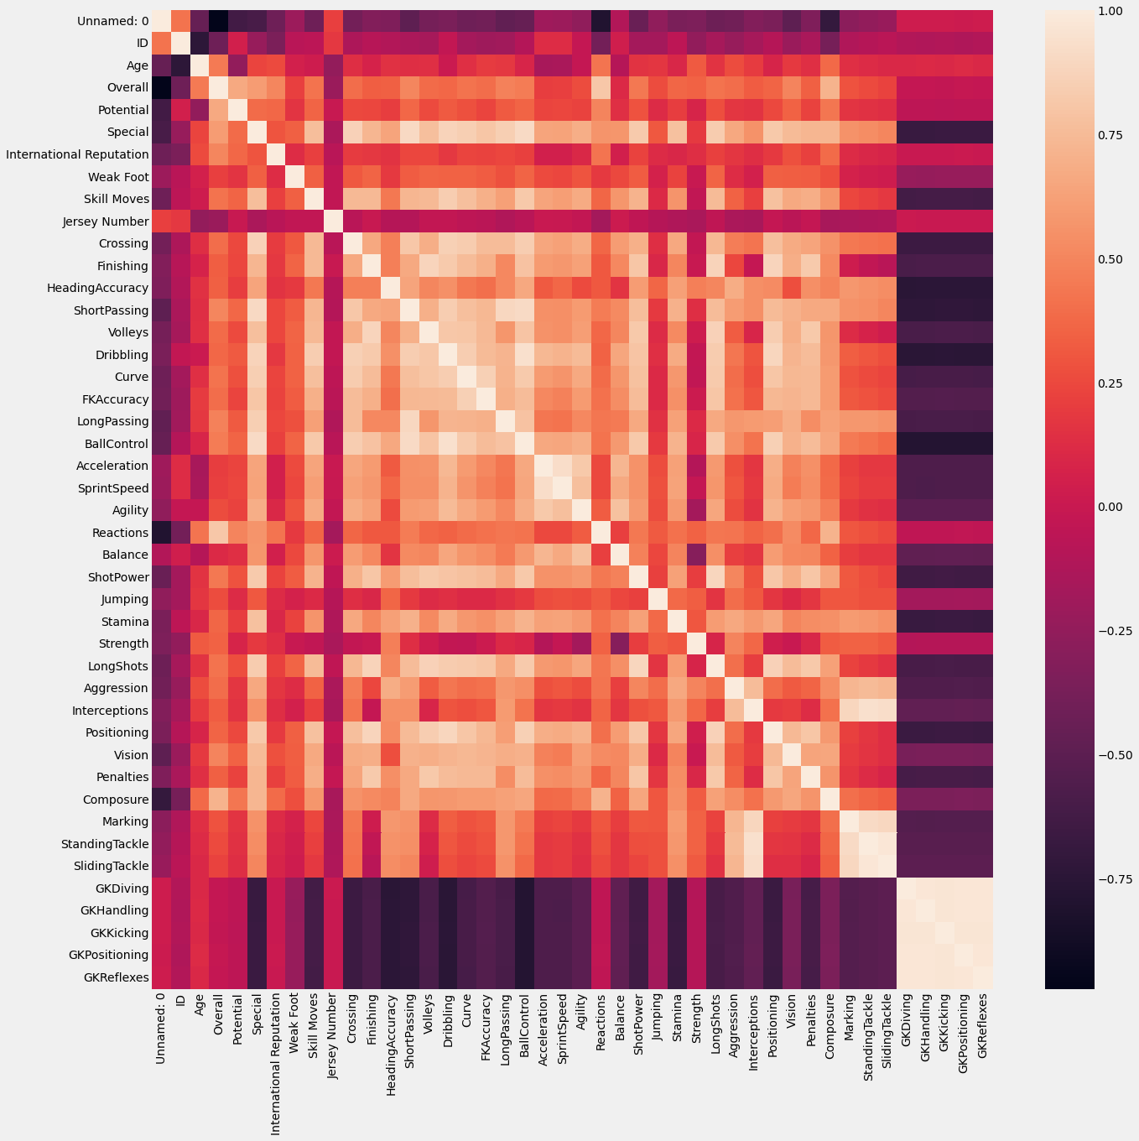
This Correlation Heatmap Showcases the skillsets of the Players available in the FIFA -19 Dataset

Slide 13
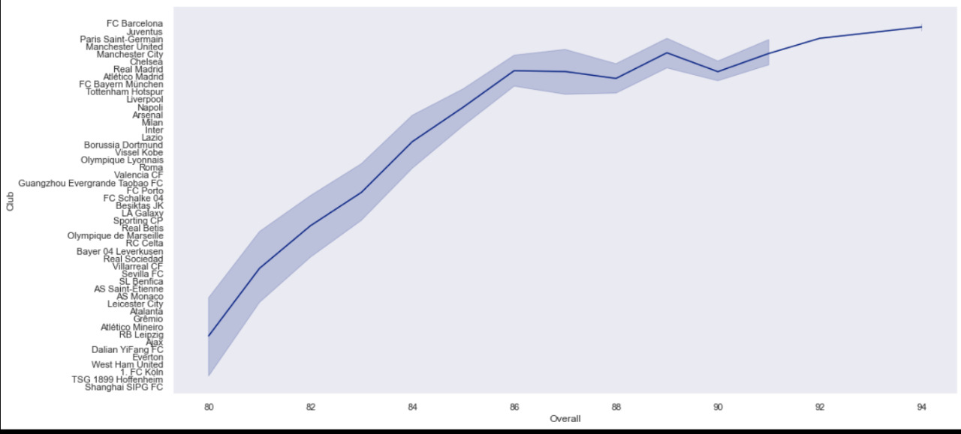
This lineplot datafies the overall club rating chart in the FIFA -19 Dataset
Inference:
FC BARCELONA has the highest overall rating

Slide 14
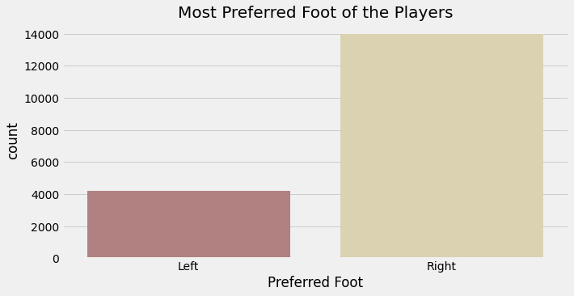
This count plot compares the preferred foot of the players in the FIFA -19 Dataset
Inference:
The players are right foot dominant

Slide 15
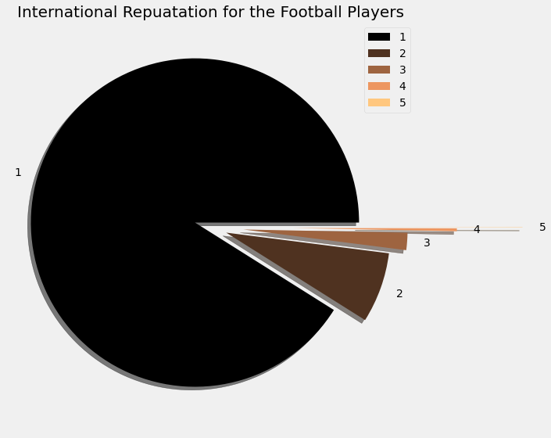
This pie chart represents the International Reputation for
the Football Players
Inference:
The reputation scale for most of the players is 1 in the scale of 5

Slide 16
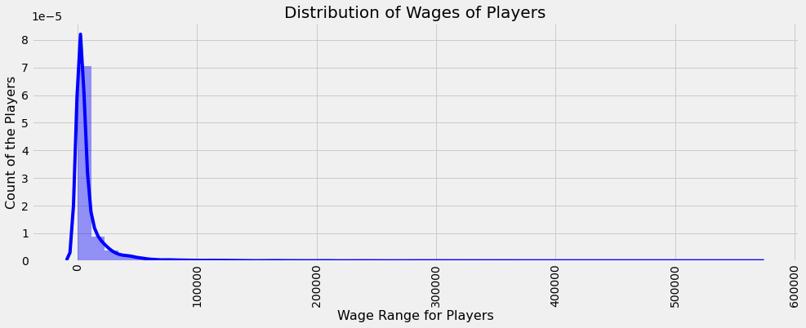
This dist plot represents the Comparing the players' Wages for the Football Players
Inference:
Distribution of Wages of Players

Slide 17
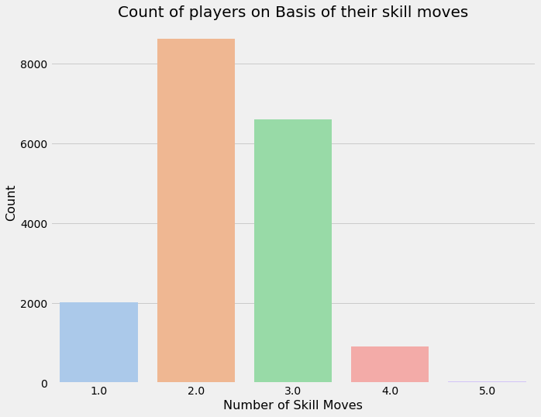
Bar chart to show count of players based on their skill moves.
Inference:
More than 8000 players with 2 skill moves and 6000+ players with 3 skill moves.
Only 1000 players with 4 special moves.(rare)

Slide 18
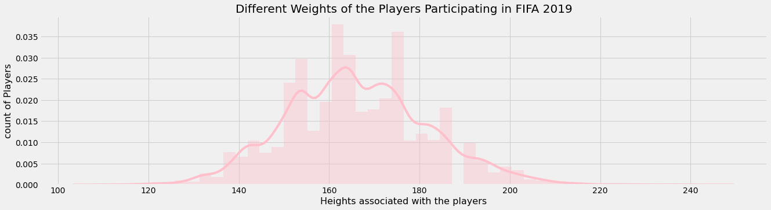
Y-axis->count of the players(PDF)
X-axis->heights of players
Inference:
Seaborn Distplot represents the overall distribution of continuous data variables. here the overall distribution is about the height of the players.(binomial distribution.)
.

Slide 19
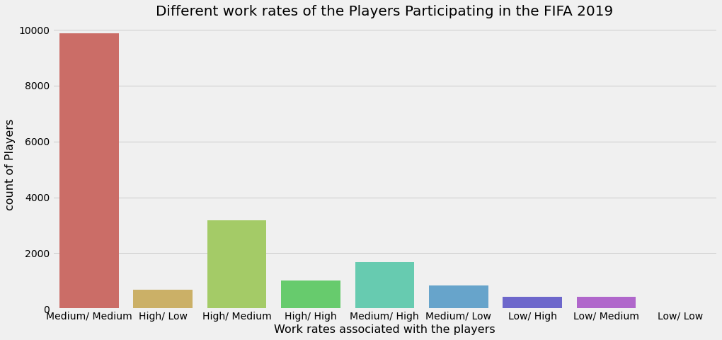
Medium/medium etc.. Refers to the attack/defense pattern
Inference:
Count plot for work rates associated with different players.

Slide 20
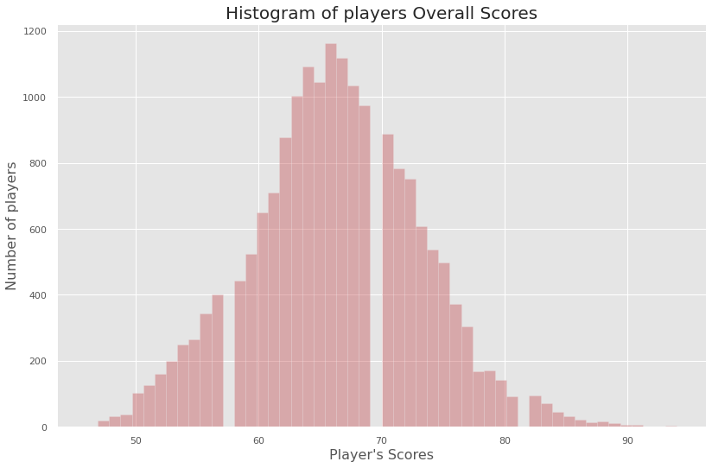
Elite players who have ratings above 80 are less than 180 in number across all competitive leagues.
Inference:
Overall scores of different players plotted over a histogram.

Slide 21
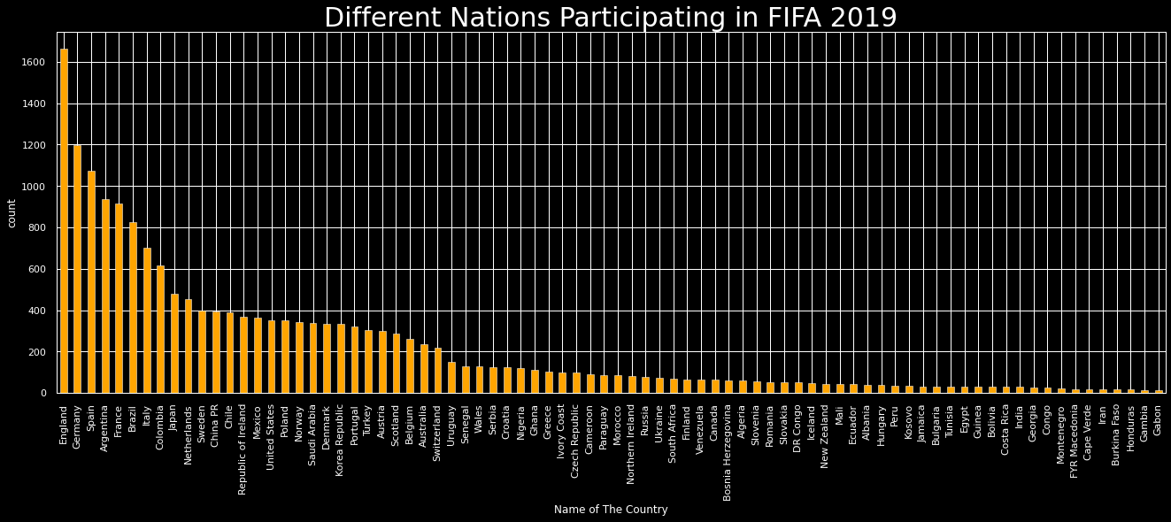
Distribution of all players from their respective countries.
Inference:
England having highest number of players participating and Gabon the lowest.

Slide 22
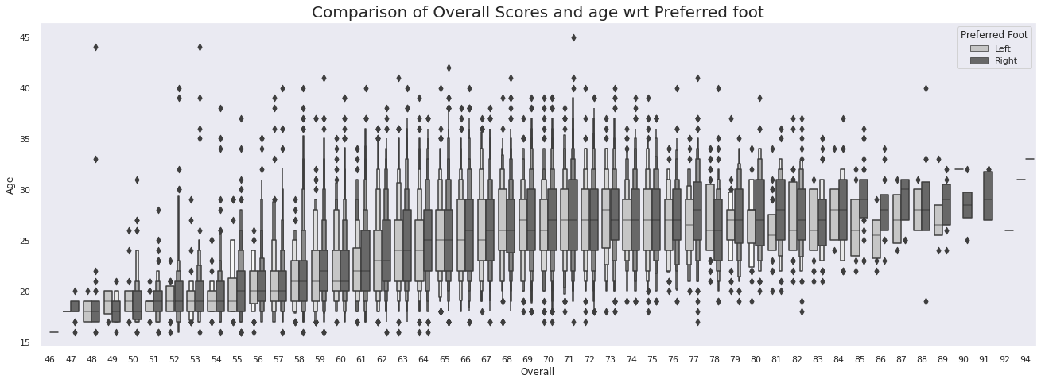
A violin plot is a hybrid of a box plot and a kernel density plot, which shows peaks in the data.
Inference:
Based on the overall ratings of the players and their age, the violin plot shows the preferred foot of the players.

Slide 23
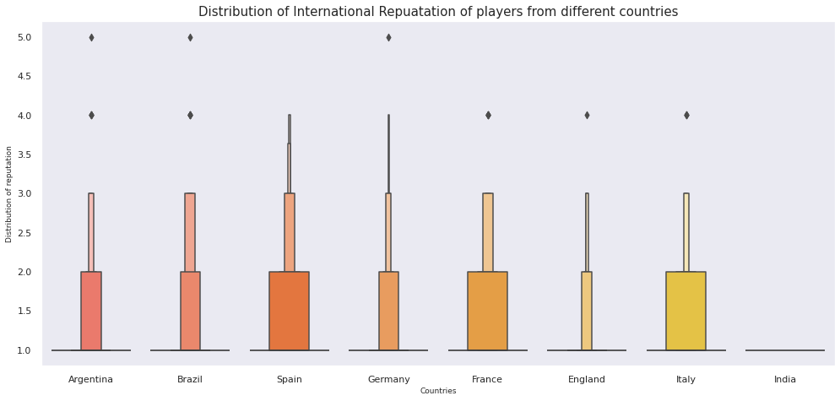
Box and whisker chart to show the distribution of players reputation based on their countries
Inference:
Players from Spain has high reputation and no players from India has international reputation yet .

Slide 24
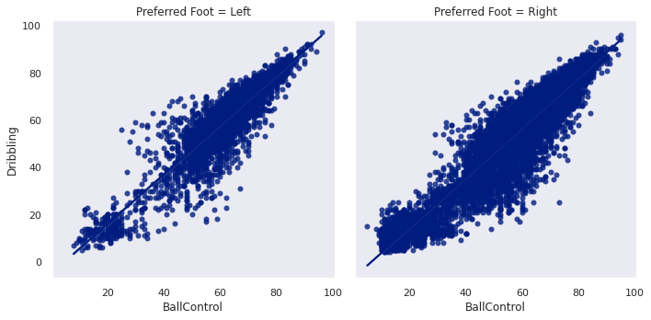
Scatter chart to show the comparison of performance of left-footed and right-footed footballers. BALL CONTROL VS DRIBBLING.
Inference:
Positive correlation is observed with variations on both left and right foot preferred players.

Slide 25
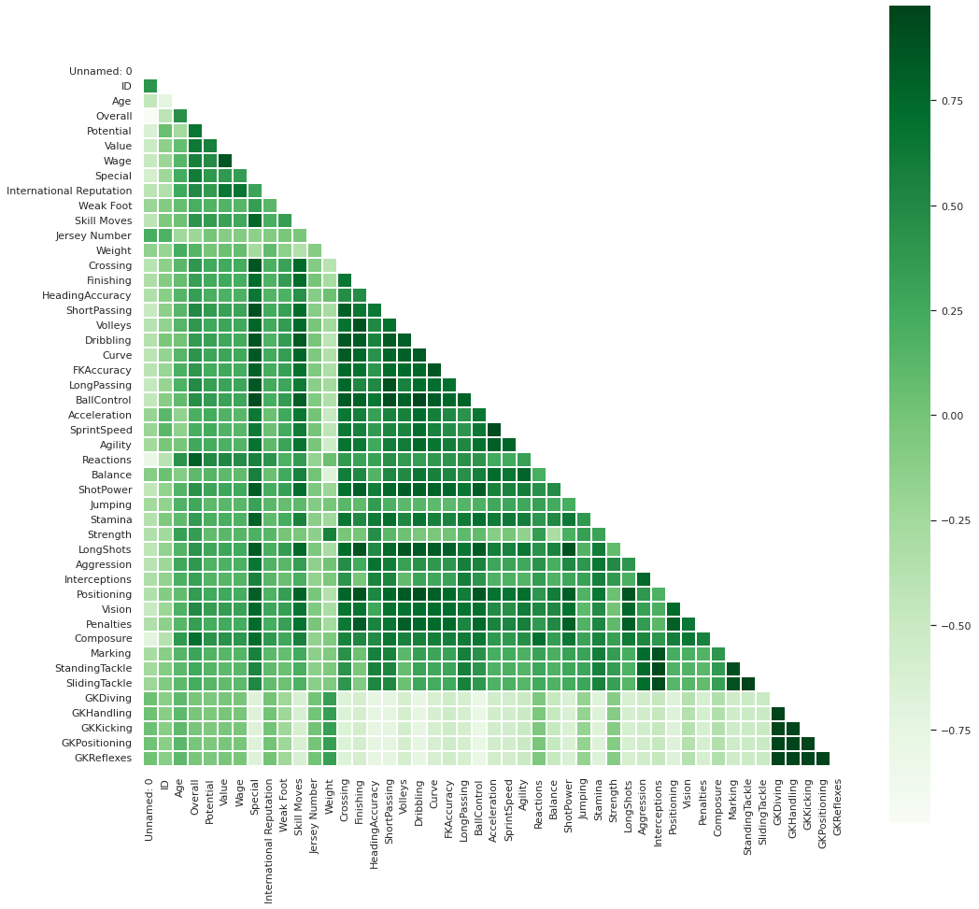
Correlation heatmap

Slide 26
Inference:
Correlation plots are used to understand which variables are related to each other and the strength of this relationship.
Here, variables like id, age, value, special score, skill moves have strong positive correlation.
While variables like goalkeeper kicking, skills, tackling have strong negative correlation.
There are several variables that have no correlation and whose correlation value is near 0.
Note: The value of correlation can take any value from -1 to 1.

Slide 27
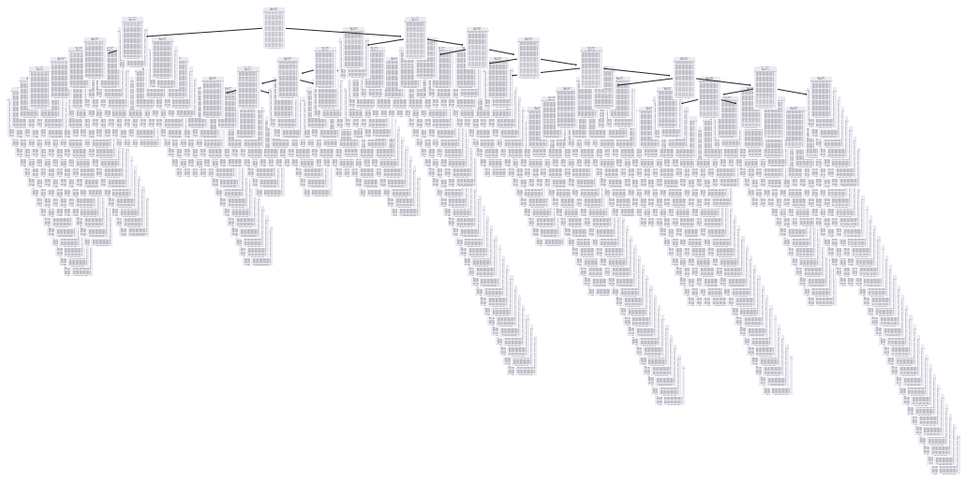
Decision tree

Slide 28
Inference:
the decision tree algorithm breaks the data points into decision nodes resulting in a tree structure.
the Decision tree algorithm is a simple yet efficient supervised learning algorithm wherein the data points are continuously split according to certain parameters and/or the problem that the algorithm is trying to solve.
The outcomes/results are observed at the tree leaves.

Slide 29
Why have we chosen decision tree over random forest ?
A decision tree combines some decisions, whereas a random forest combines several decision trees. Thus, it is a long process, yet slow. Whereas, a decision tree is fast and operates easily on large data sets, especially the linear one(FIFA -19 is a linear Dataset). The random forest model also needs rigorous training

Slide 30
WIDELY USED MACHINE LEARNING ALGORITHMS
LINEAR REGRESSION
LOGISTIC REGRESSION
DECISION TREE
SVM ALGORITHM
KNN ALGORITHM
NAIVE BAYES ALGORITHM
This has been implemented in the Sports Prediction Model

Slide 31

THANK YOU <3
We have made this a presentation for easier explanation and understanding of the different aspects of our case study. (Sports prediction)

